Slide 1

The hardware
AI is expensive...
Hardware
0
0

Slide 2
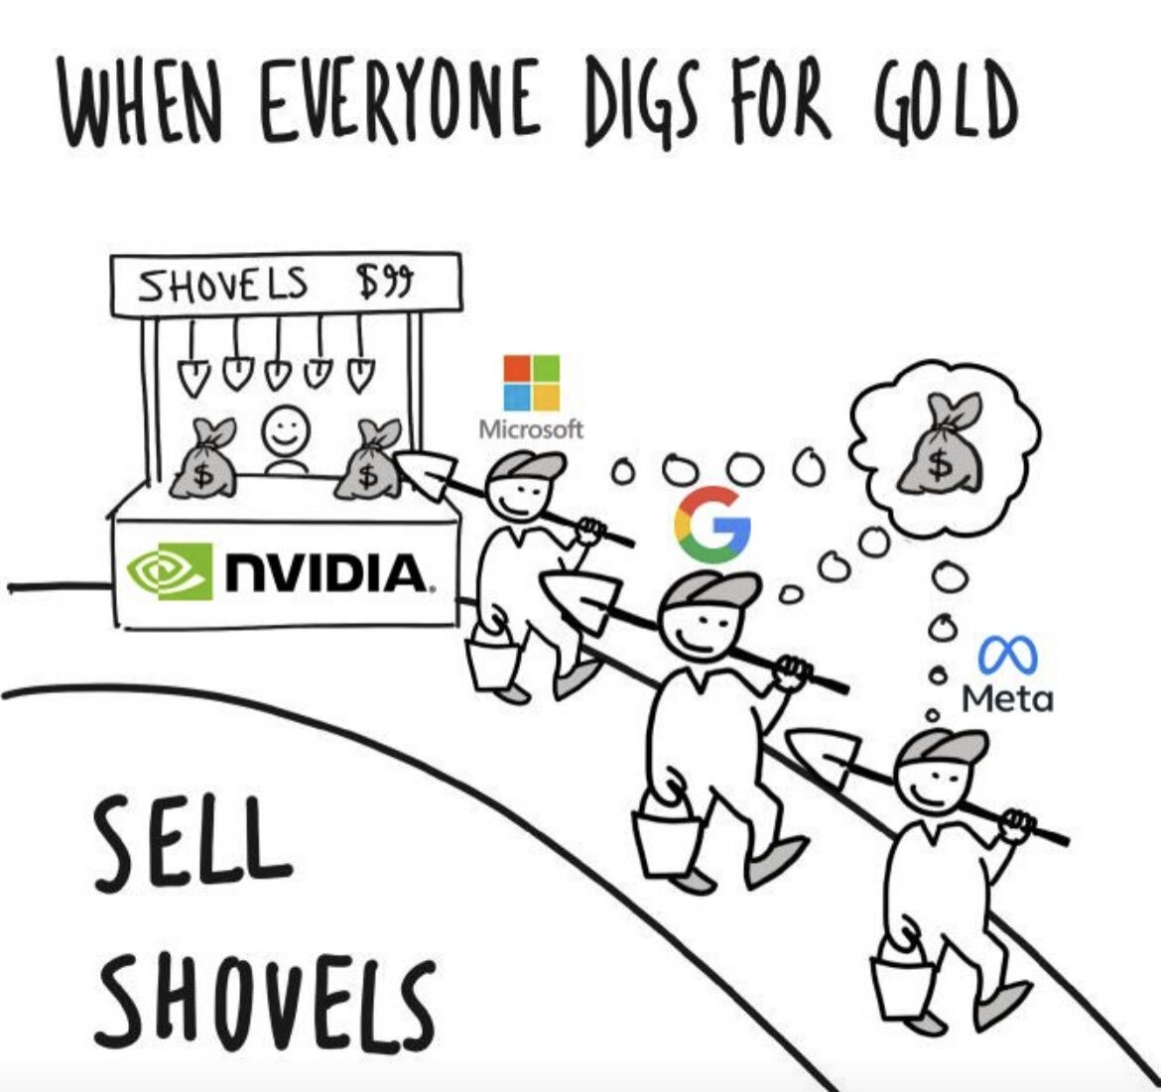

Slide 3
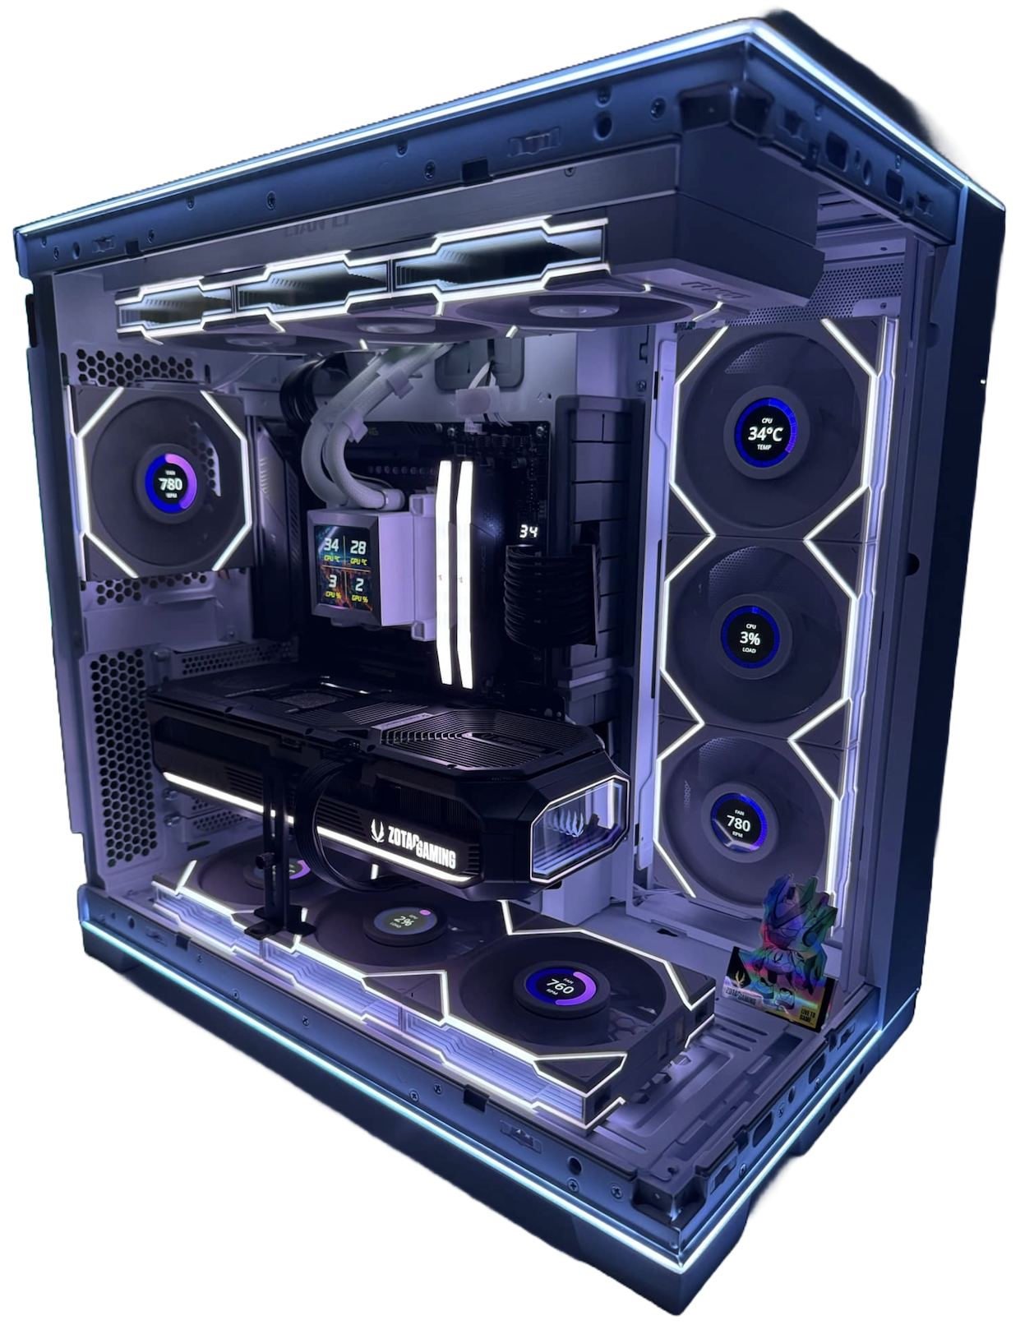
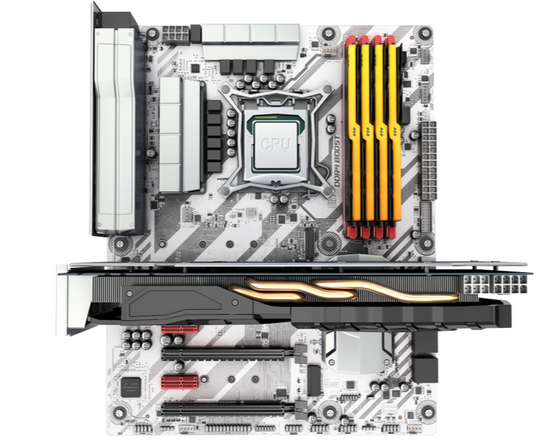
Computer Hardware

Slide 4

Computer Hardware

Slide 5
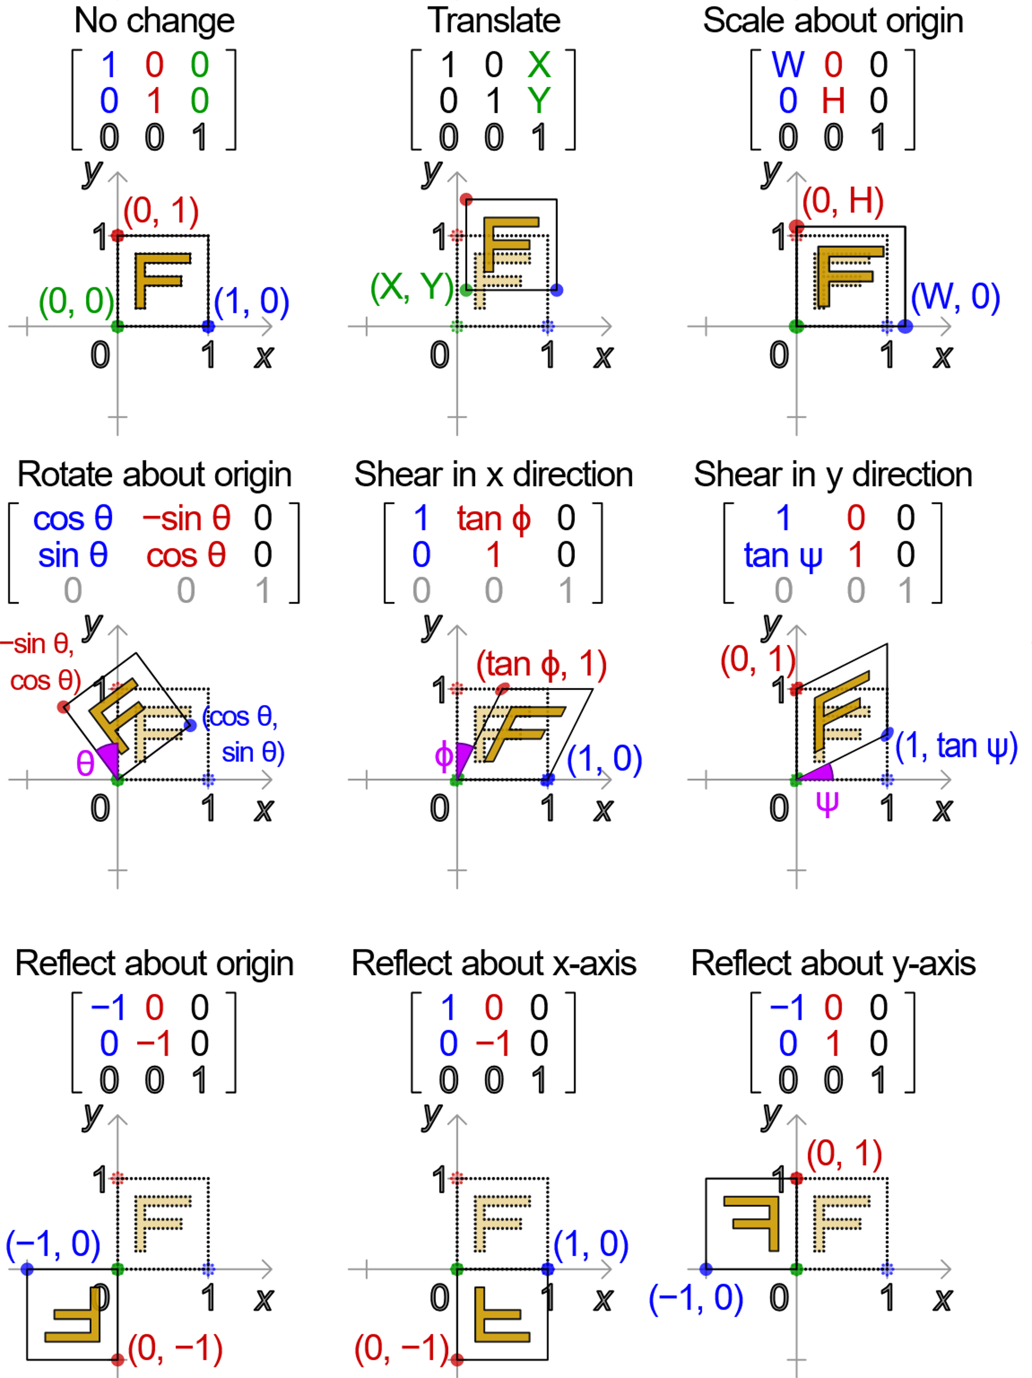
Matrix Operations:
By Cmglee - Own work, CC BY-SA 3.0, https://commons.wikimedia.org/w/index.php?curid=35180401

Slide 6
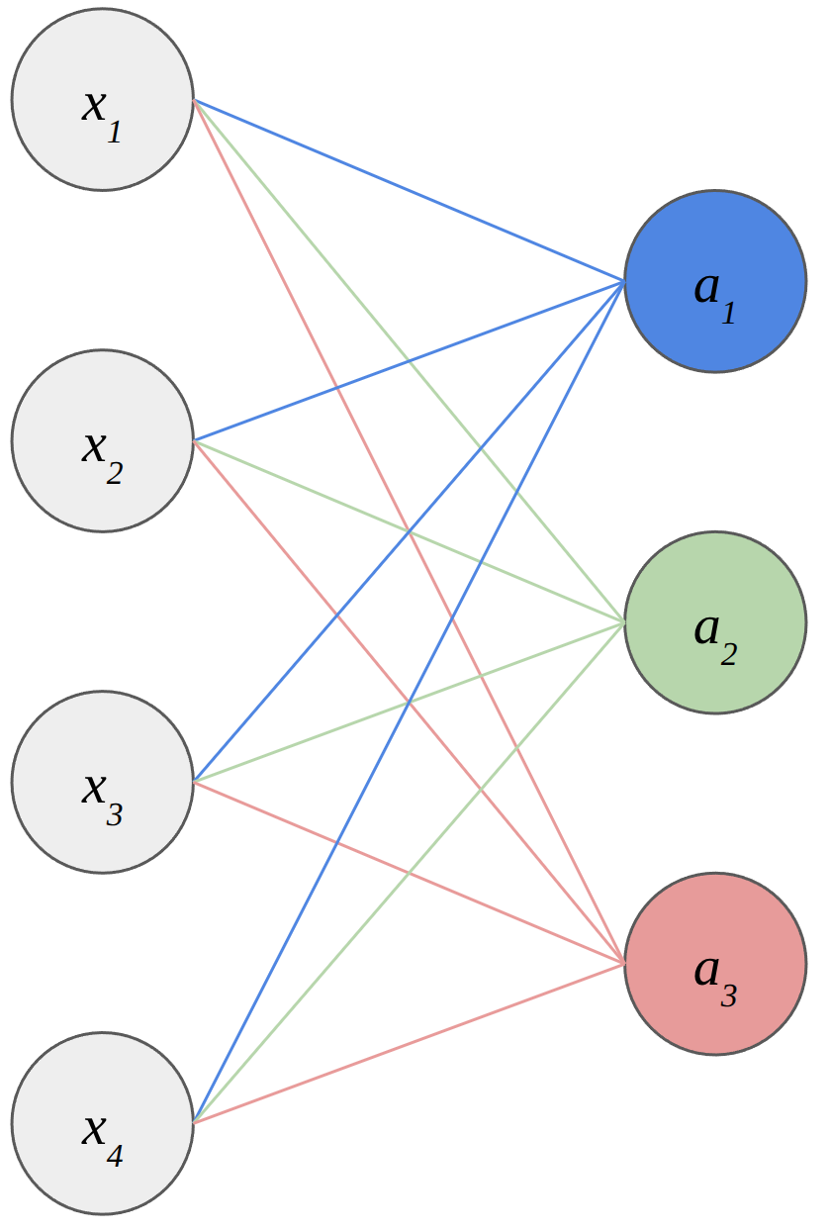
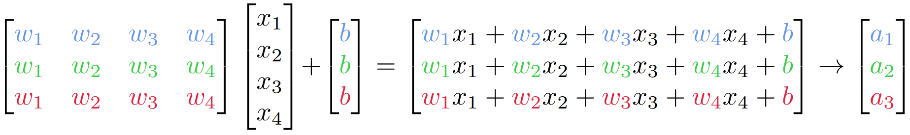
Turns out that AI is basically the same
Inputs: arrays of numbers
Weights: arrays of numbers

Slide 7
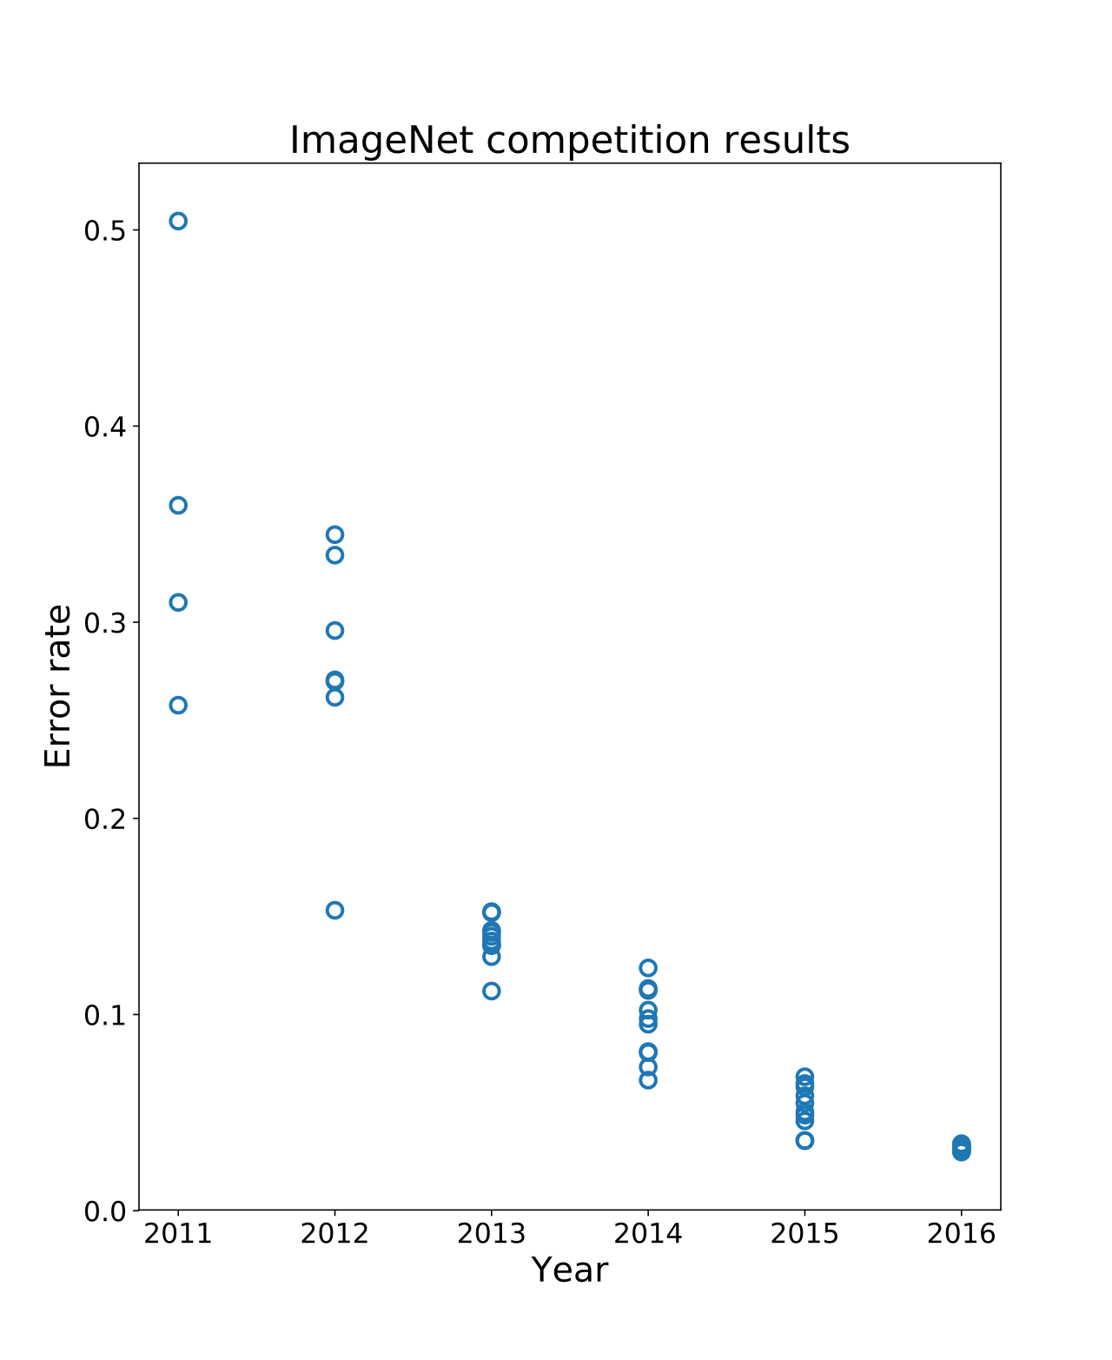
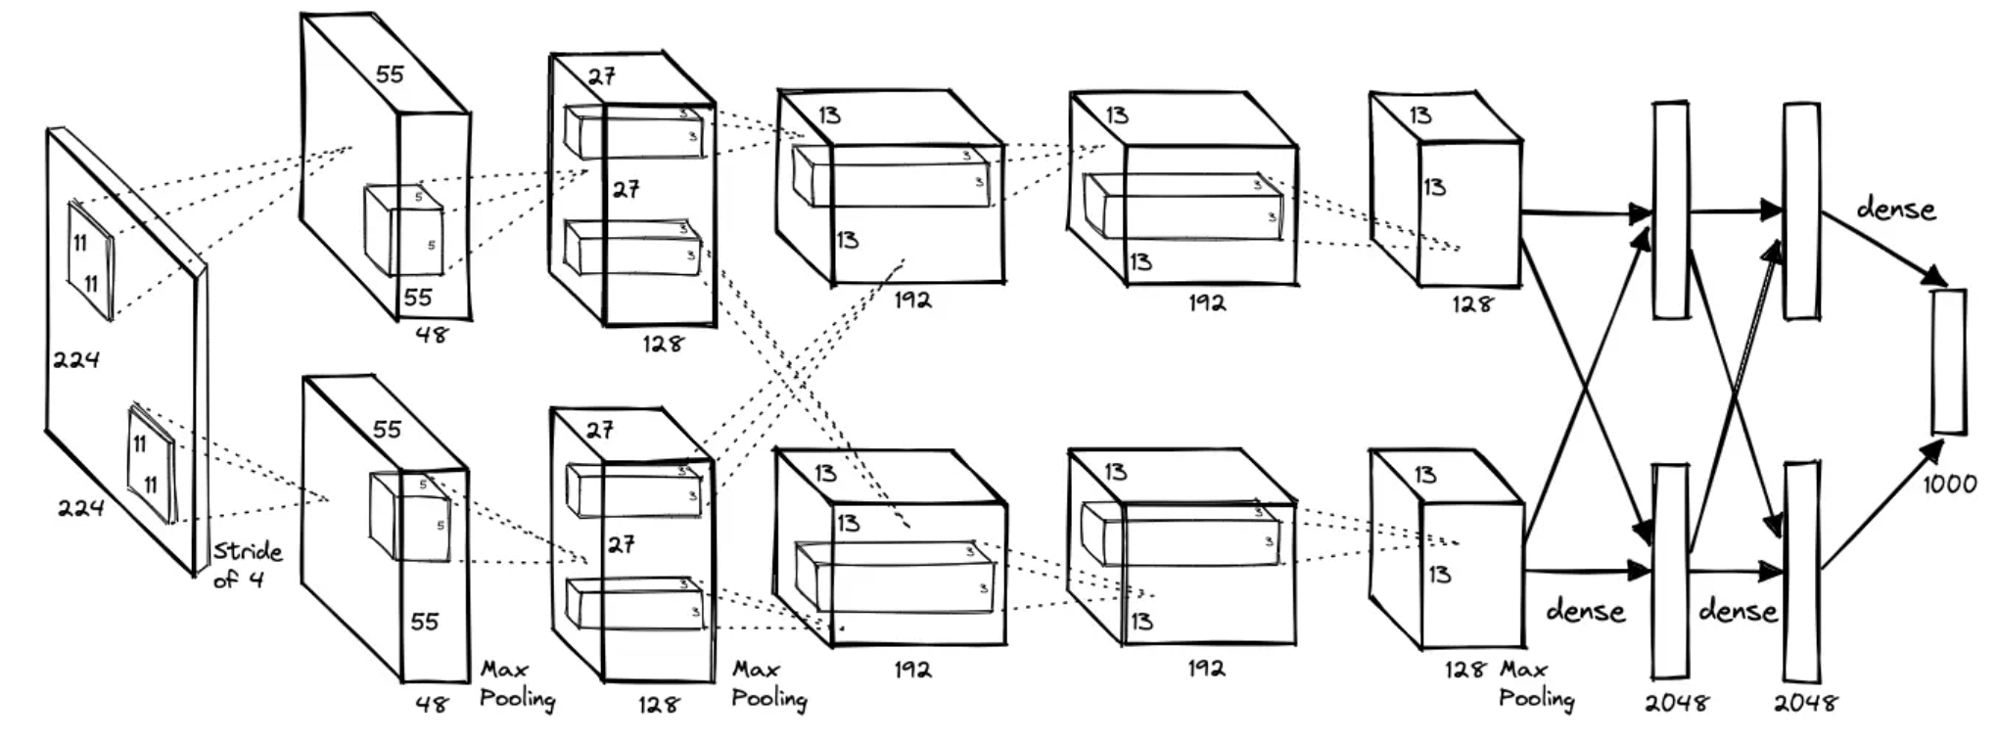
Milestone #1
https://proceedings.neurips.cc/paper_files/paper/2012/file/c399862d3b9d6b76c8436e924a68c45b-Paper.pdf

Slide 8
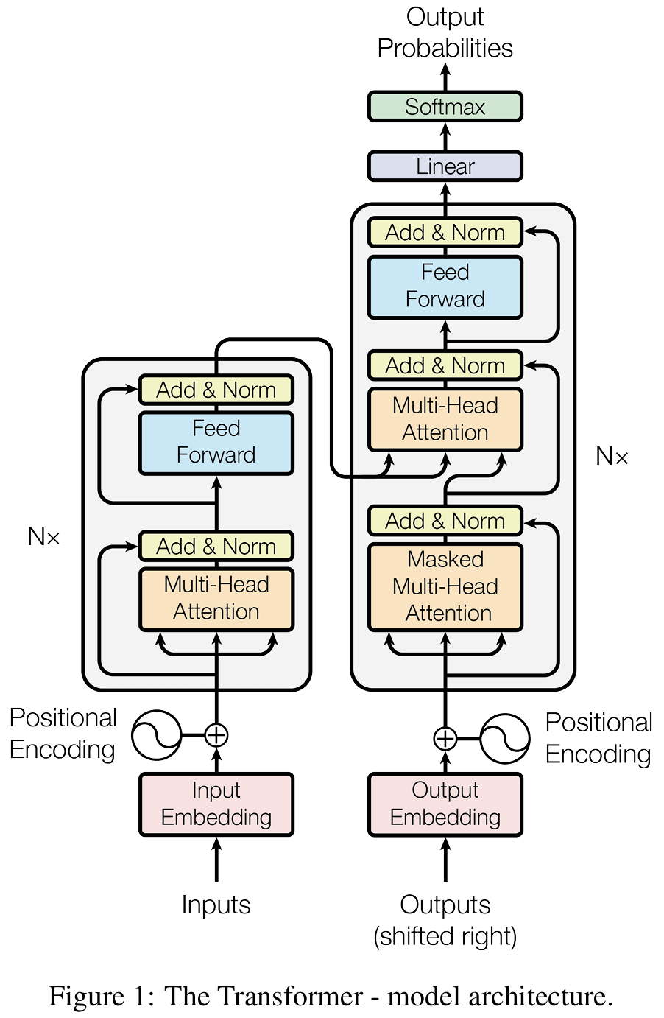

Milestone #2
https://arxiv.org/abs/1706.03762

Slide 9
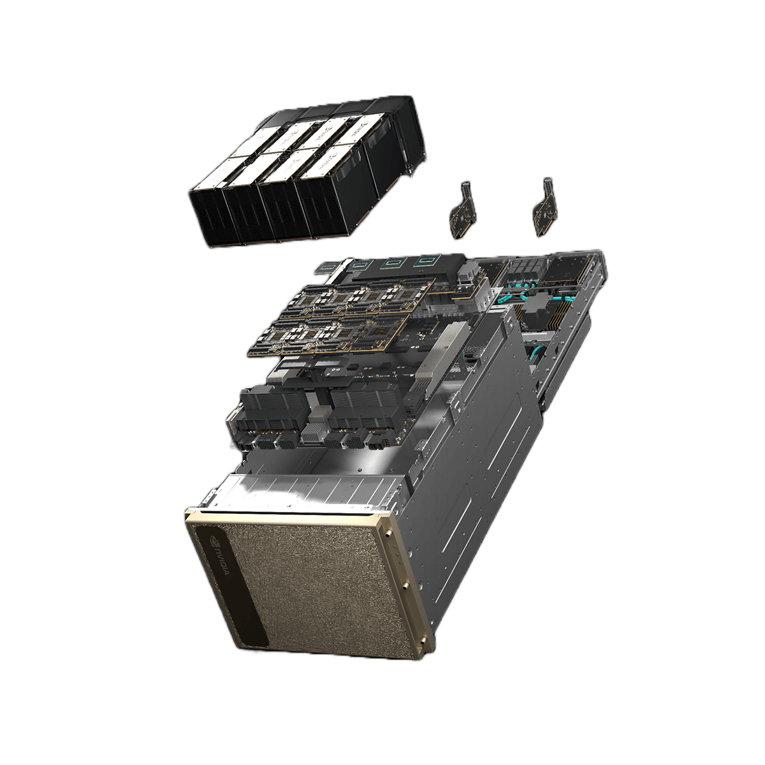

Data centres

Slide 10
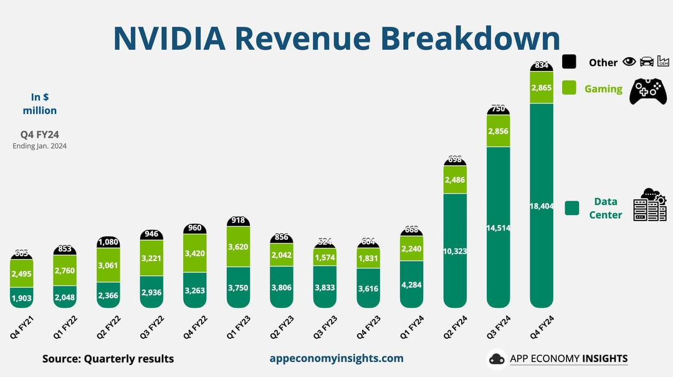

Slide 11
Some Nvidia GPUs
Previous Gen
A40
A10G
V100
A(4,5,6)000
A100
Current Gen
L40(S)
RTX Pro 6000
H100
H200
B200
Gaming
RTX 10xx, 20xx, 30xx, 40xx, 50xx

Slide 12
The competition
AMD
Commercial:
CPU
Ryzen series
GPU
Radeon
Pro:
CPU
EPYC
Threadripper
GPU
Instinct MI300 / MI350
Intel
Commercial:
CPU
Core i-series
GPU
Arc
Pro:
CPU
Xeon
GPU
Ponte Vecchio
Flex

Slide 13
The Nvidia moat
CUDA!!
Allows developers to "speak" to the GPUs
Specialized libraries
CuDNN
CuBLAS
Changing is high risk

Slide 14
Special mentions
AMD ROCm
Nvidia DGX Spark
Huawei
...the important thing is the software stack and memory bandwidth

